Slide 1
Executive Director Briefings Autumn 2020 Tue 29th September, 18.30 Fri 2nd October 09.30

Slide 2
Strategic Children’s Services Update
Tolis Vouyioukas
Executive Director, Children’s Services

Slide 3
Strategic Children’s Services Update
Leadership throughout Covid
Current position across Children’s Service
Buckinghamshire Council

Slide 4
Public Health Update
Dan Flecknoe
Public Health Consultant

Slide 5
Public Health challenges
The changing shape of the pandemic
Testing demand vs testing capacity
Burn-out and polarising attitudes
Guidance fatigue
Seasonal Influenza
Winter pressures

Slide 6
Public Health approaches
Prevention and preparedness.
Consideration of both the direct and indirect impacts of the pandemic – protecting those who are most vulnerable to each type of impact.
Working with partners across the health & social care system to produce reliable information, understandable guidance and effective coordinated action.
Listening to our colleagues and residents – what could we be doing to support you better?

Slide 7
Educational setting issues
Balancing guidance and reality – every school has their own specific barriers to “perfect” implementation.
Primary school/EYS age children are very low risk for acquiring or transmitting COVID-19.
Secondary school age children may be closer to adult transmission risk (although still very low risk for severe illness), but can follow precautions.
Minimising numbers of potential contacts for a confirmed case in the school.
Bubbles
Consistent seating & knowledge of social groups
Encouraging parents to take responsibility for behaviour outside school

Slide 8
Education Update
Simon James
Service Director, Education

Slide 9
3 Principles
All efforts must focus on making a difference for children
A fundamental focus on partnership between schools and the Local Authority
Easy and fast communication to Headteachers

Slide 10
Service Updates
A review of the School Improvement offer to ensure all schools benefit
Focus on the speed of Early Help assessment and intervention
Improved speed of SEND assessments
Improved quality of Education, Health and Care Plans
Lower exclusions of pupils with special needs
Higher % of pupils with special needs in mainstream schools
Attainment gap between disadvantaged and non disadvantaged pupils

Slide 11
Other Priorities
Keeping children safe
Safer recruitment – esp. references and complaints
Keeping children local
Ofsted inspections:
School inspections
Safeguarding inspections
SEND inspections
Budgets
DSG – balanced for 2020-21
Additional £8m for high needs for 2021-22

Slide 12
Children’s Social Care Update
Richard Nash
Service Director, Social Care

Slide 13
Response To Covid-19
Children’s Social Care response to pandemic proved to be effective.
The service was able to keep a strong grip on keeping vulnerable children safe.
This was achieved by:
1) Supporting staff to complete physical visits in the community safely.
2) Keeping Children’s Homes open.
3) Supporting Foster Carers to continue caring for existing and new children who come into care.
4) Issuing Minimum Practice Standards in relation to ‘Virtual Contacts’ with children, young people and their families.
5) Having strong grip and control through audit and data sets.
Regular communication with OFSTED, Department for Education and our Improvement Partners, Hampshire County Council.

Slide 14
Impact of Covid-19 on vulnerable children and young people.
The experiences of the Service indicate that there has been changes in the seriousness of incidents involving children.
These include more adult mental health incidents involving parents, including parental suicide.
More incidents of children and young people having poor mental health.
Increase in the seriousness of Domestic Violence incidents.
Increases in incidents relating to birth parent conflict, particularly in relation to contact.
Increases in indicators of, and incidents of serious youth violence linked to the criminal exploitation of young people.
The significant negative impact of schools not being available for children and young people, particularly those with additional needs.

Slide 15
The next few months
Clearly the next few months will be challenging for all of us.
With regard to vulnerable children it will be important that all agencies continue to work effectively together.
We want to retain the positives that have emerged in terms of the use of modern technology to support our work.
Capitalise on the extent to which the importance of schools has been underlined for many of our families.
QUESTIONS?

Slide 16
Governance Update
Paul Randall
Buckinghamshire Association of School Governors

Slide 17
Agenda’s for this term - what Boards need to consider
Governing Board Meetings and Visits for this term – how to plan for these
Safeguarding – ensuring that your schools & boards have an effective culture for safeguarding
NGA Membership & Learning Link – ensure you have signed up
Buckinghamshire Council Governor Training – virtual sessions planned for this term

Slide 18
BASG Events
Autumn Term – Focus with Sam Henson NGA Director of Policy and Information
Spring Term – BASG AGM – with Key Note Speaker Emma Knights OBE Chief Executive of the NGA – 14th January 2021

Slide 19
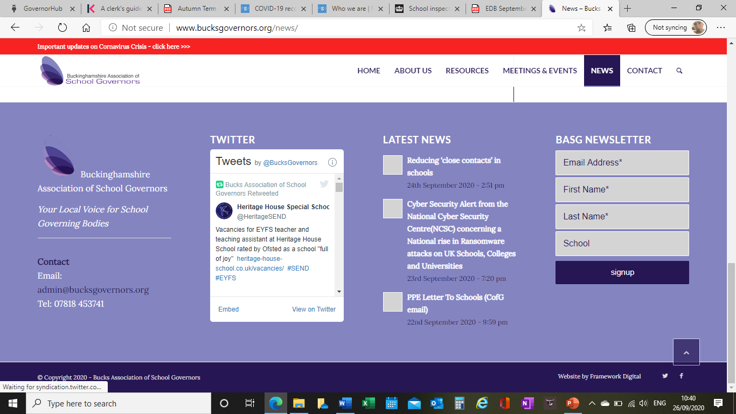
All Governors in Buckinghamshire are full members of BASG, including members of academy and MAT boards and those of Local Governing Bodies within MATs. Please ensure you have signed up!
http://www.bucksgovernors.org/news/

Slide 20
Questions from Headteachers

